Slide 1
Let us make our second device
What?
Smart light that will glow when it gets dark
Stops glowing when it is not dark
Why?
Understand Sensor, Actuator, Controller
Learn about Input / Output Pins Arduino uses to talk to the sensors and actuators.
Learn how to provide instructions (also called “Sketch”) for Arduino that provide the behavior to the device
Notes:
+ 45 minutes
Break??
Activity #2 Introduction – 10 minutes

Slide 2
Sensors
Sense the world.
Examples:
Light sensor
Sound sensor
Temperature sensor
Location (GPS)
Orientation sensor
Distance sensor

Slide 3
Actuators
Change the world
Examples:
LED – bring light
Speaker - sound
Motor – Move
Relays/Switches
Robotic arm - Move

Slide 4


How does Arduino talk to sensors and actuators?
Input pins
sense voltage
Output pins
provide voltage
5Volt = 1 5Volt = 1023
0Volt = 0 0Volt = 0
1 = 5Volt 255 = 5Volt
0 = 0Volt 0 = 0Volt
Off
Off
On
On

Slide 5
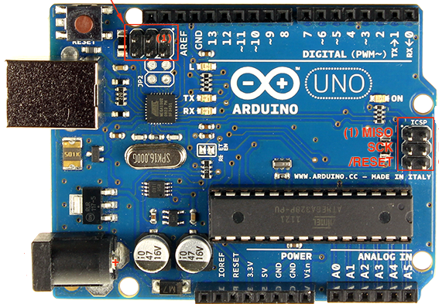

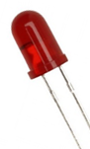
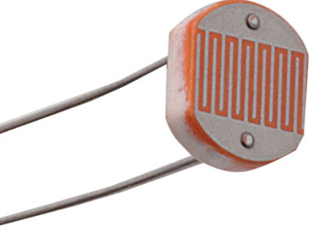
How does the device work?
Instructions
Input pin
Output pin
Actuator
Light Sensor

Slide 6
Digital Output Pin
Device (our LED circuit) is connected to the output pin
Arduino generates signal on the pin
The device receives the signal and acts
Example: Signal on the port is set to HIGH (5 Volts) to “Power-On” the LED
5 Volts
Start
0 Volts
Turn
On
Turn
Off
Turn
On
Turn
Off

Slide 7
Analog Input Port
Signal on the port is measured as a number between 0 and 1023
Example
If voltage on the port is 5 V, value of the input is measured as 1023
If voltage on the port is 2.5 V, value of the input is measured as 612
If voltage on the port is 0 V, value of the input is measured as 0
Notes:
+ 55 minutes
Activity #2 Building 25 minutes

Slide 8
Step 1: Assemble the components on the breadboard

Slide 9
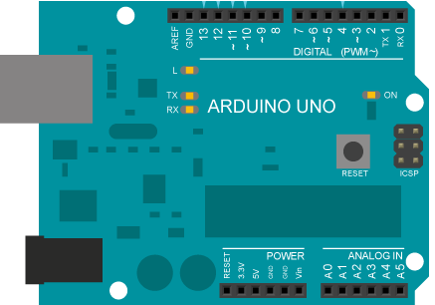
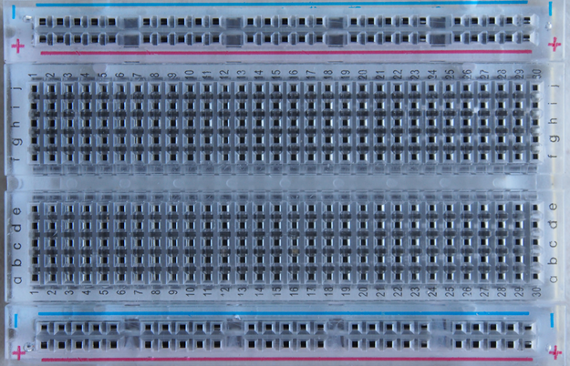
The wiring diagram
9 Volt
LED
10KΩ
LDR
LED
270 Ω

Slide 10
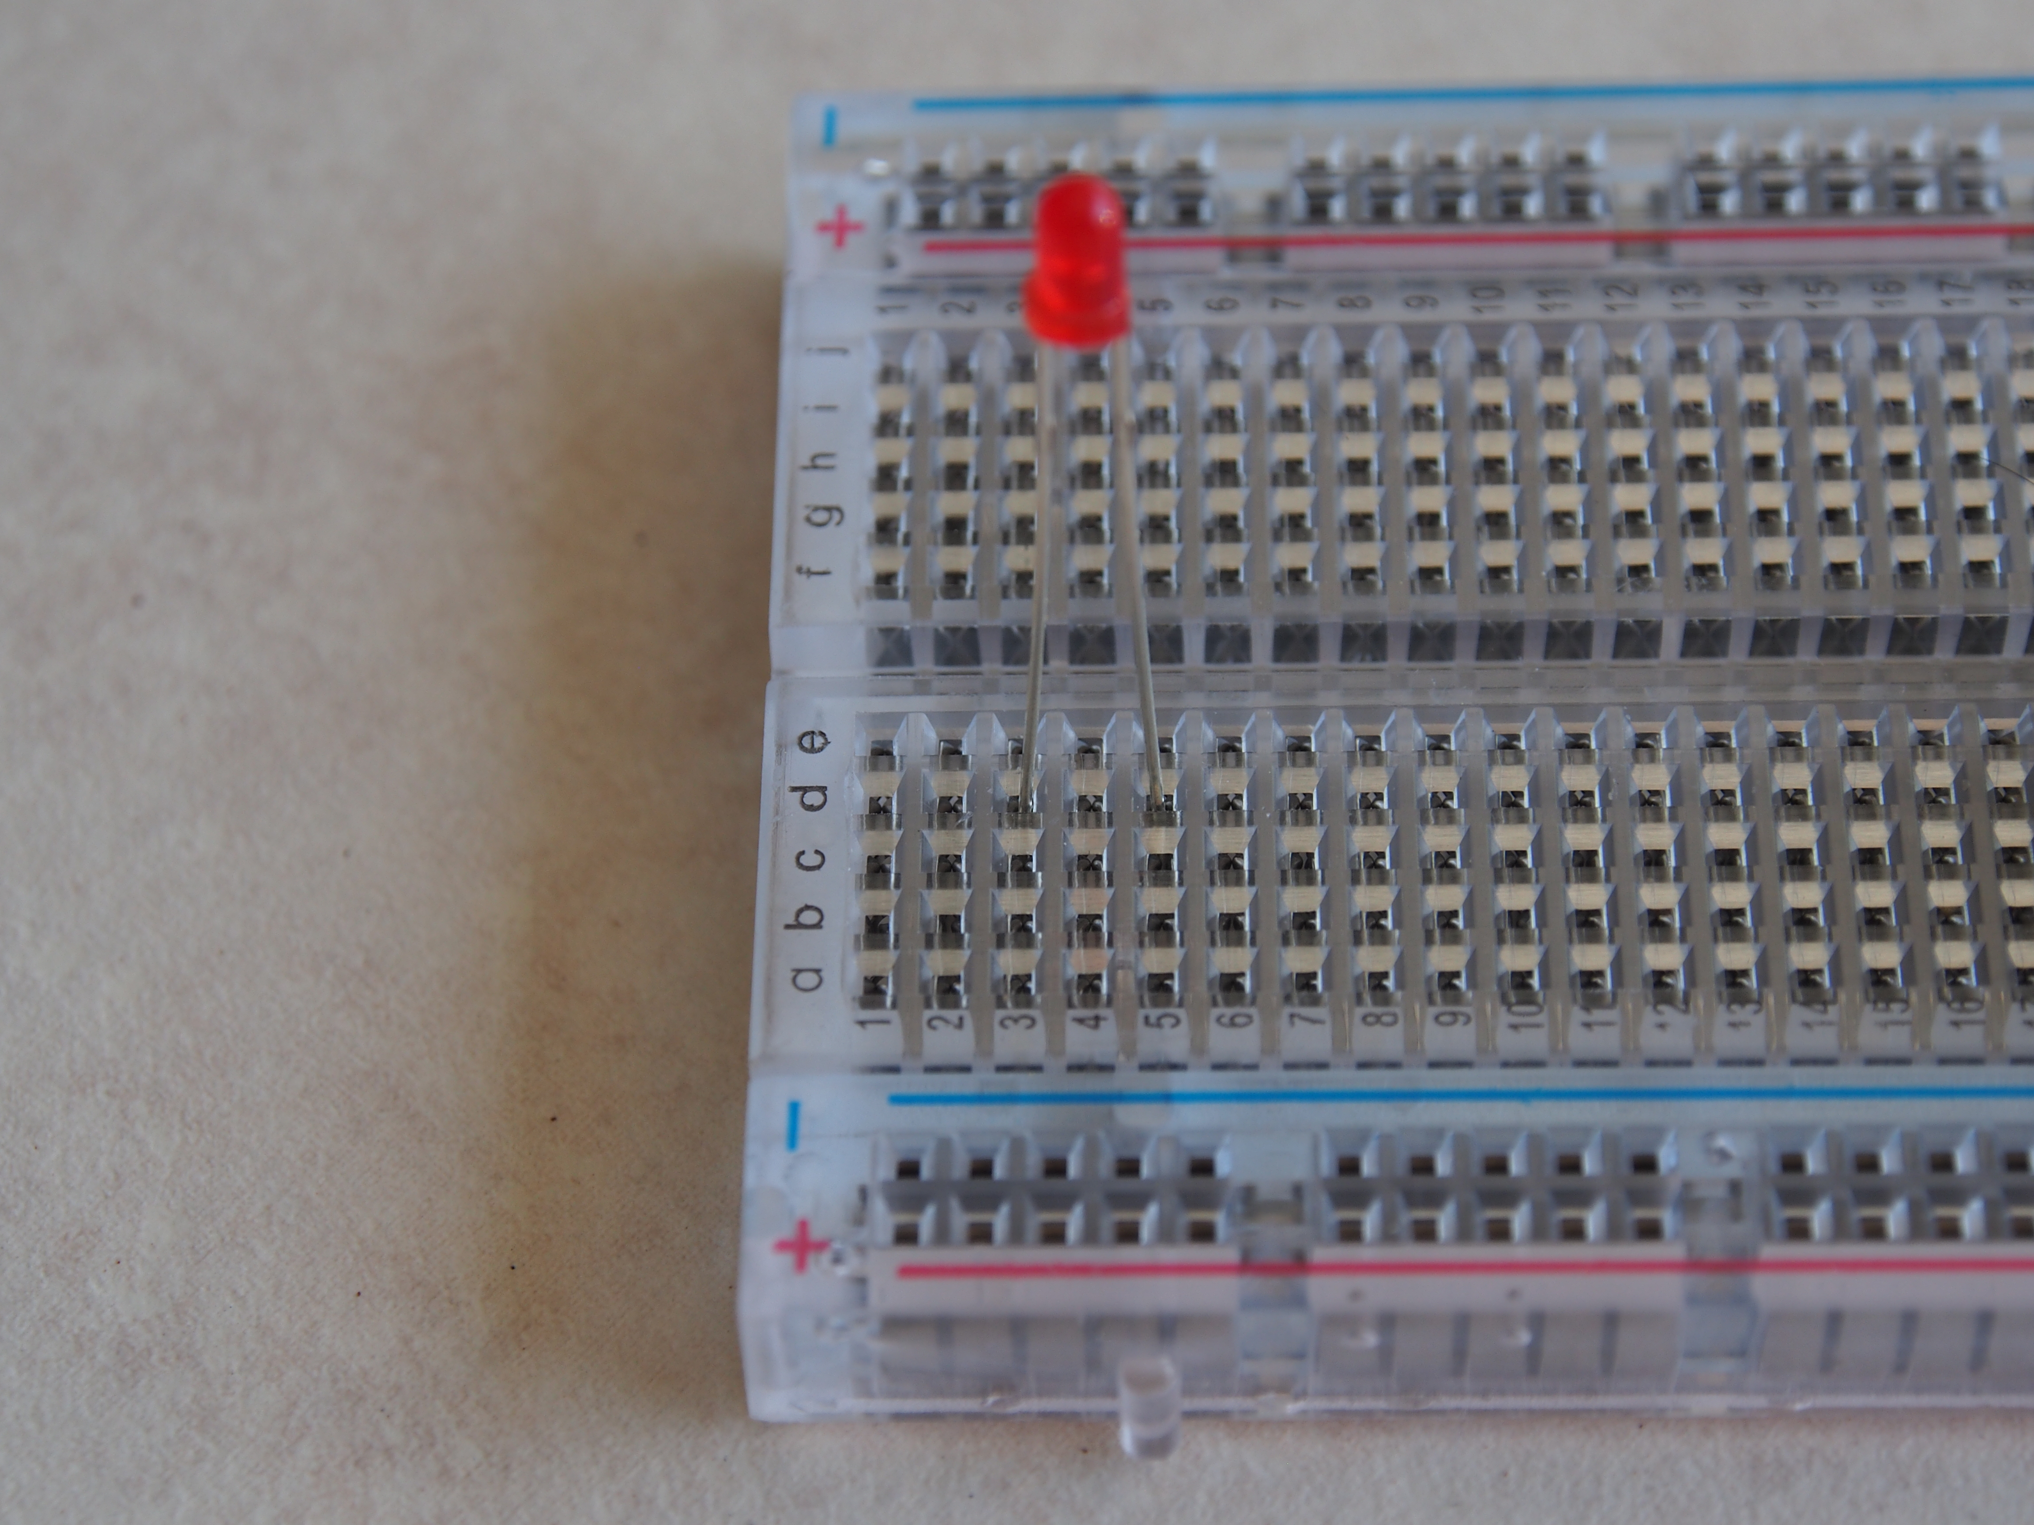
Insert the LED on breadboard
+ Rail inward
Insert long leg in d3
Insert short leg in d5

Slide 11
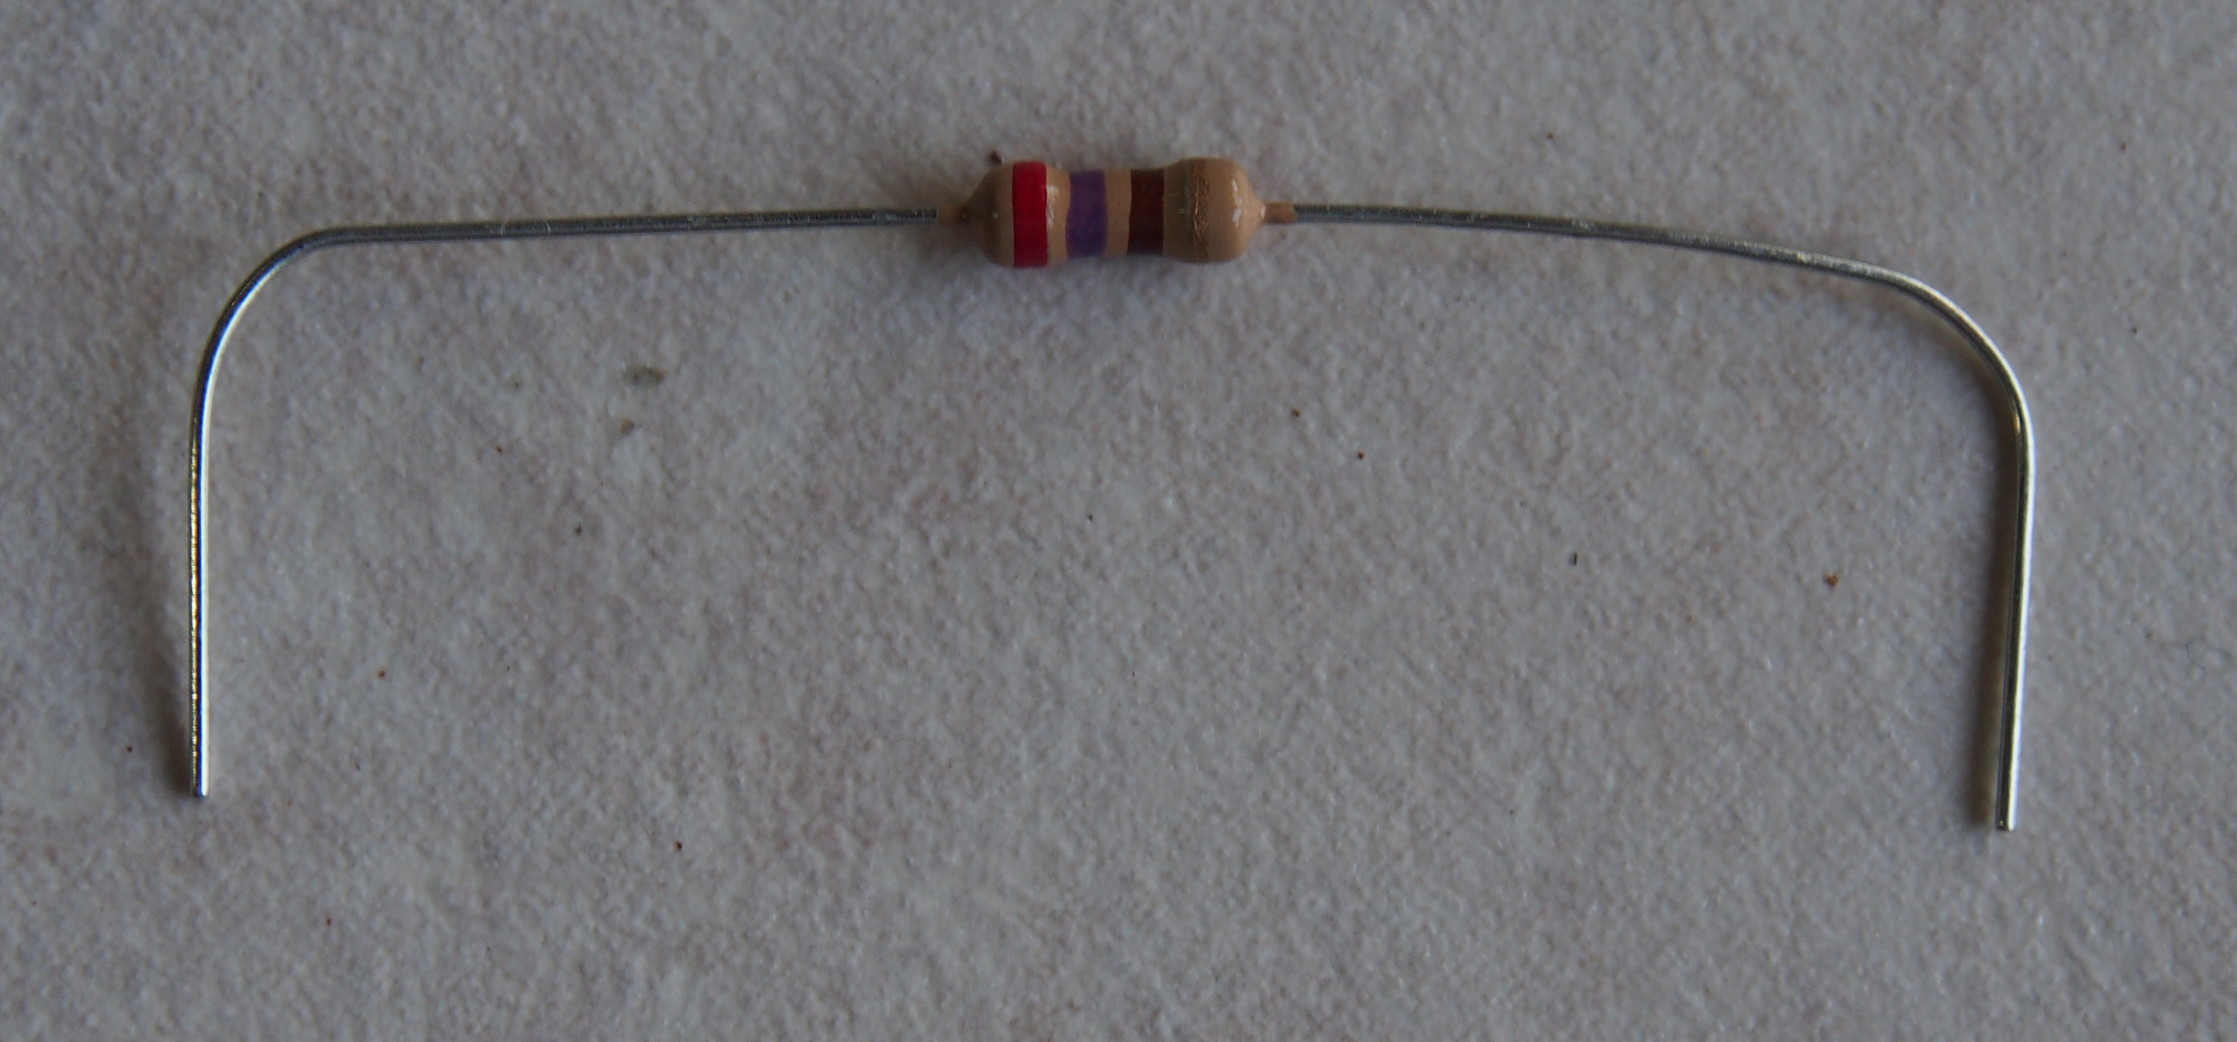
Insert the 270 Ohm resistor
Insert one leg in a5
Insert other in a21

Slide 12
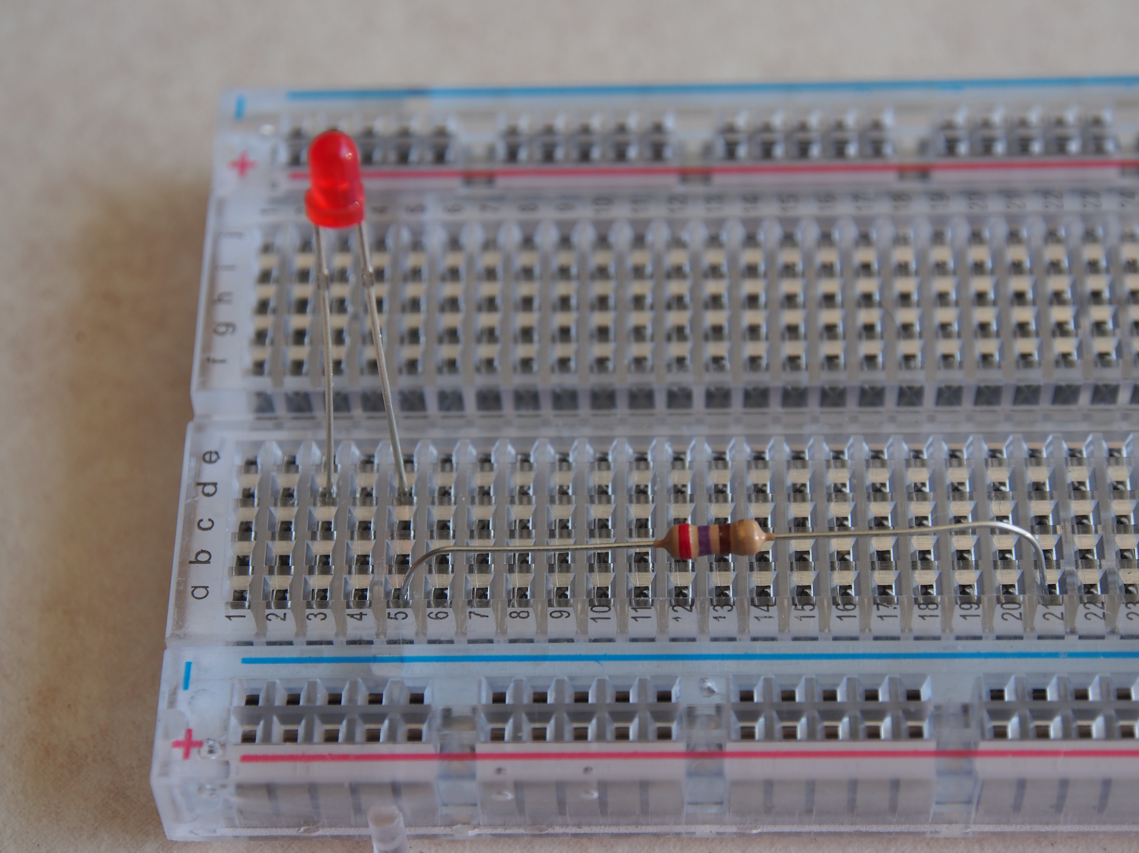
Insert the 270 Ohm Resistor
Insert one leg in a5
Insert other leg in a21

Slide 13
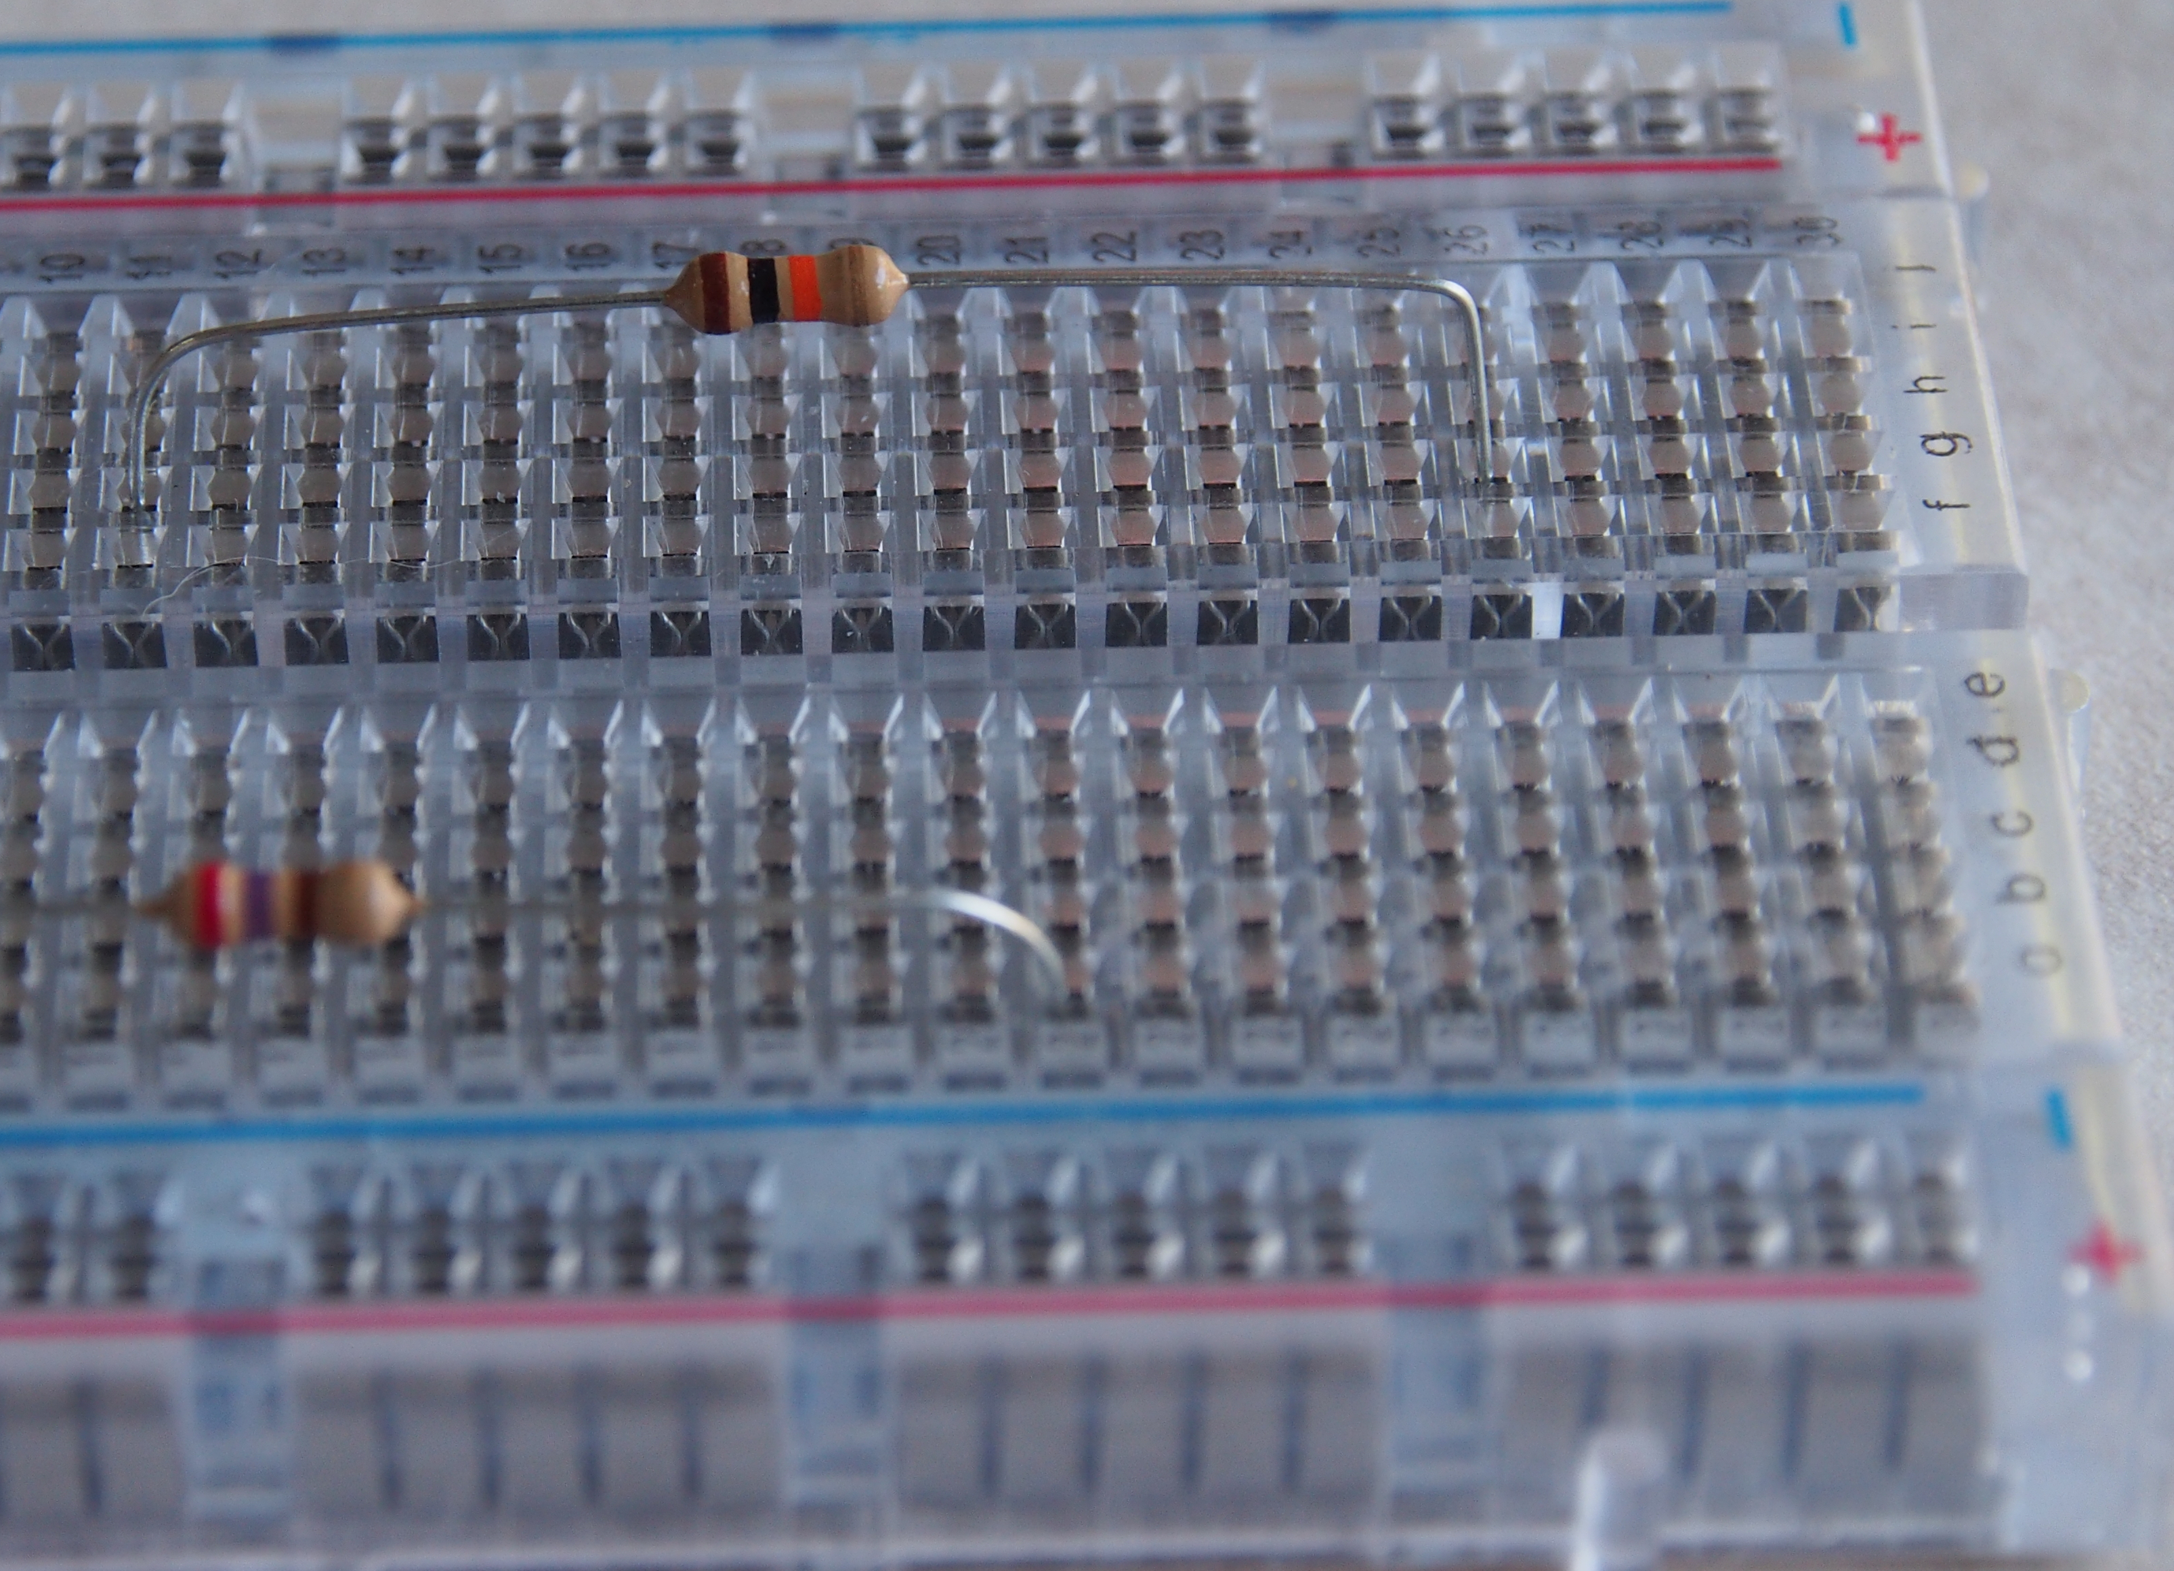
Pick, bend and insert 10Kilo Ohm resistor
Insert one leg in g26
Black Ring
Brown
Ring
Orange Ring
Insert other leg in g11

Slide 14
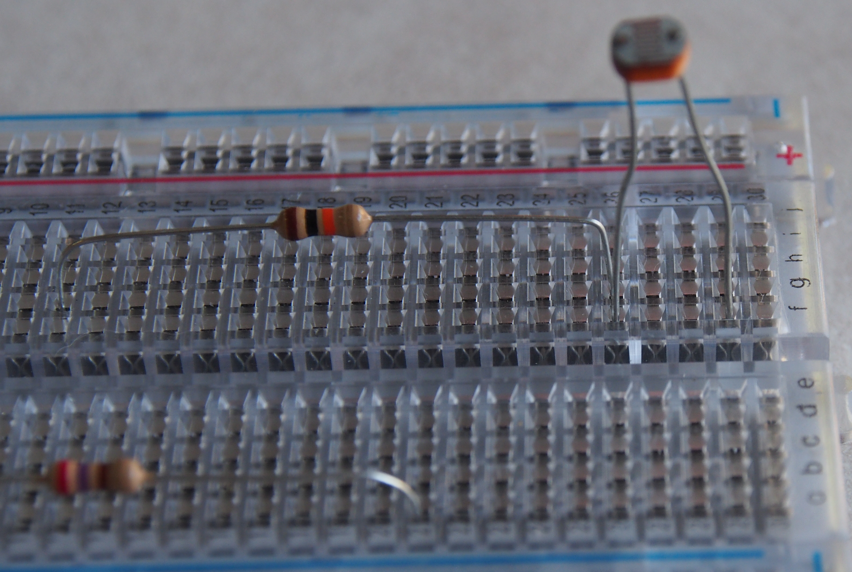
Pick & insert the Light Dependent Resistor (LDR)
Insert one leg in f26
Insert other leg in f29

Slide 15
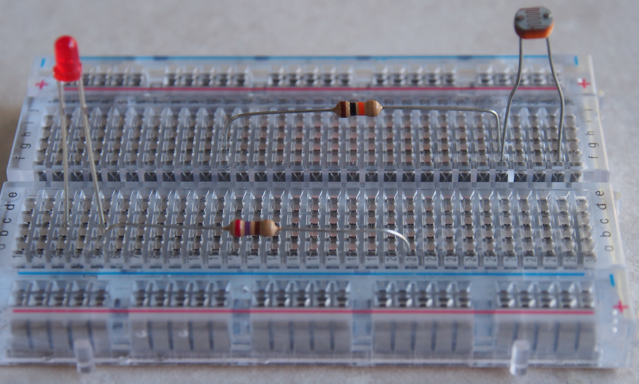
Breadboard should look like ….

Slide 16
Step 2: Connect wires on the breadboard
> Use shorter wires for connecting components on the board

Slide 17
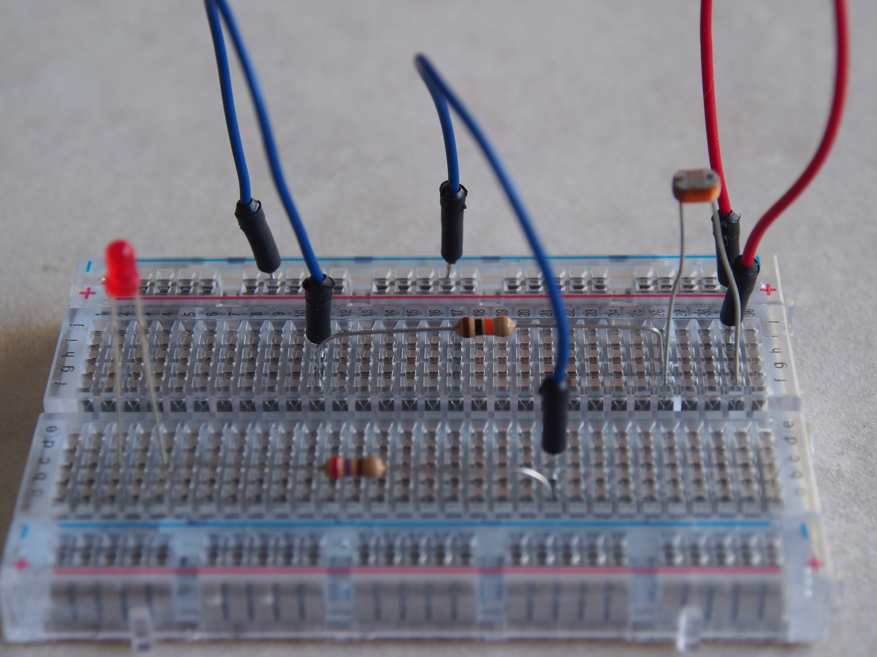
Connect Minus rail to i11 blue wire
Connect Minus rail to c21 using blue wire
Connect Plus rail to j29 using red wire

Slide 18
Step 3: Connect wires between breadboard and Arduino
> Use longer wires for connecting the board to Arduino

Slide 19
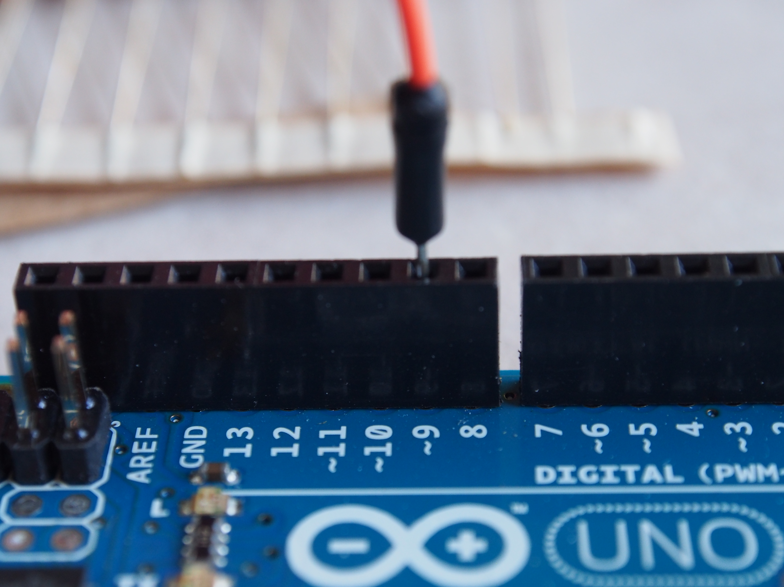
Connect pin 9 on Arduino to e3 on breadboard using orange wire

Slide 20
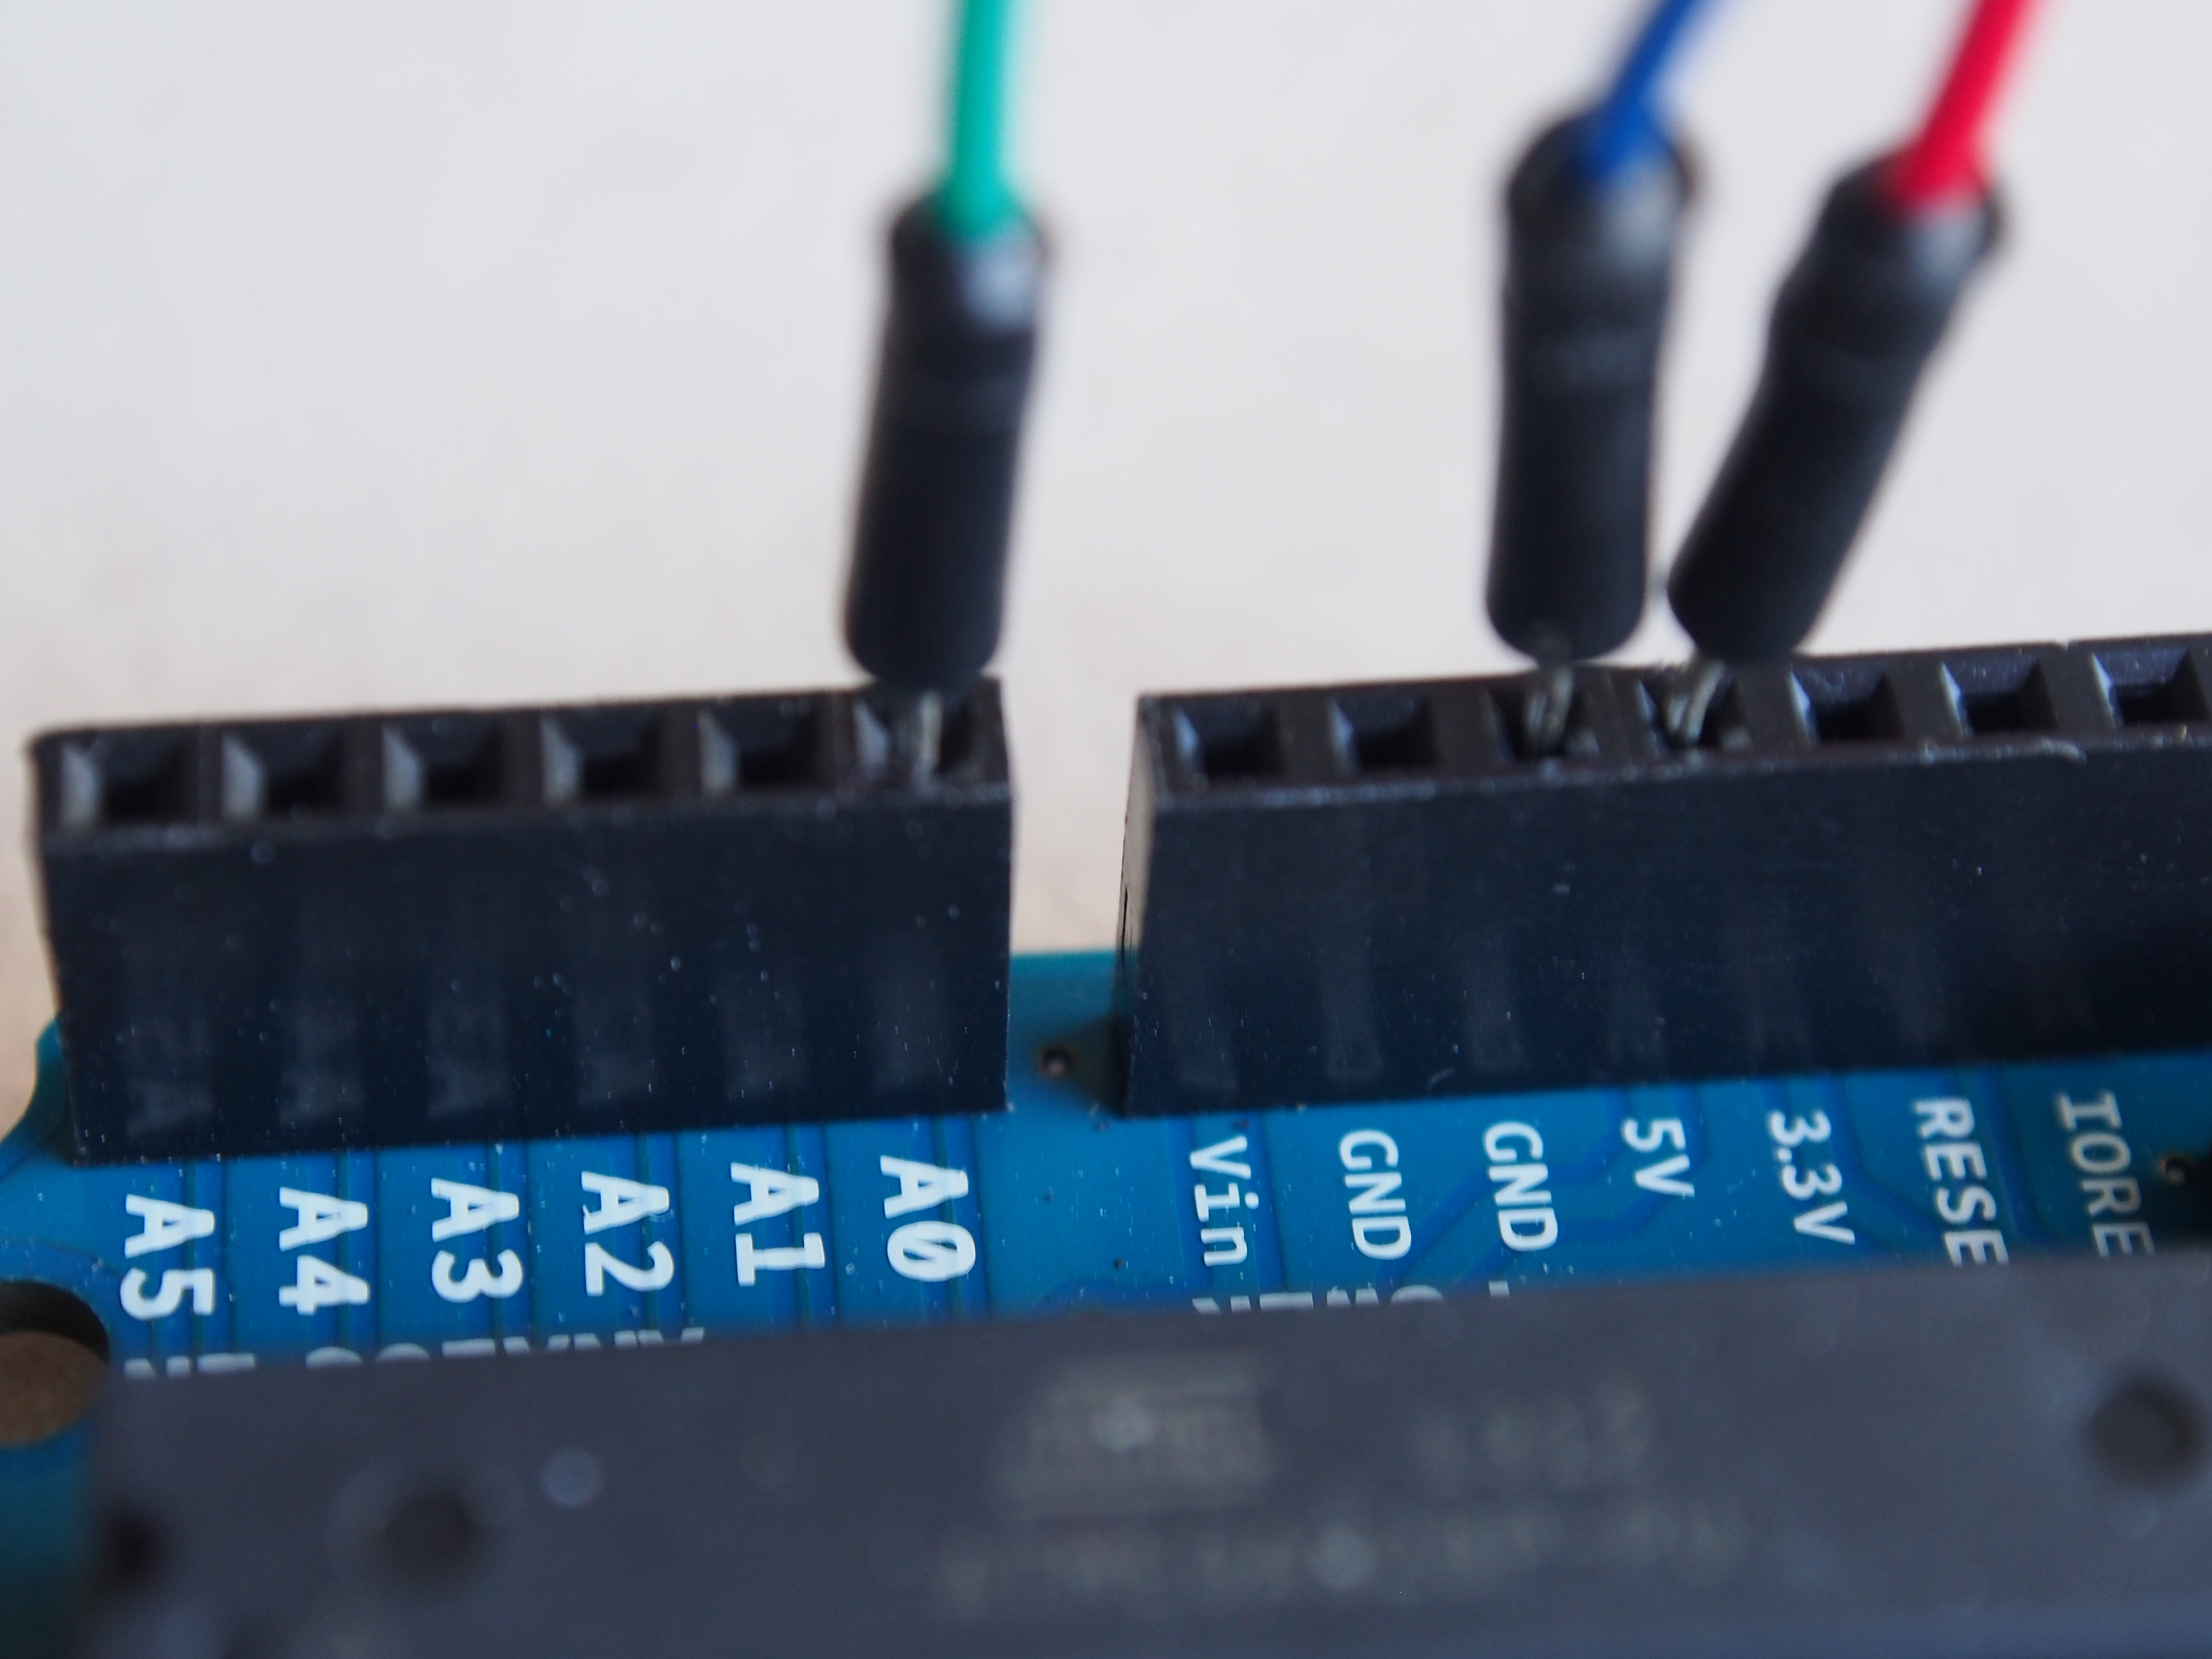
> Connect pin A0 to i26 using green wire
> Connect pin 5V on Arduino to Plus Rail on breadboard using red wire
> Connect pin GND on Arduino to Minus Rail on breadboard using blue wire

Slide 21
Step 4: Write instructions and upload to Arduino

Slide 22
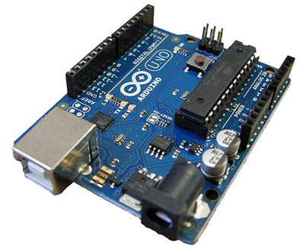
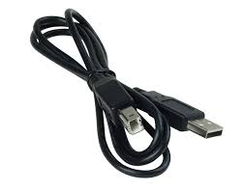
Connect Arduino to the computer
> USB cable
> USB
Connector
> To computers USB
Port

Slide 23
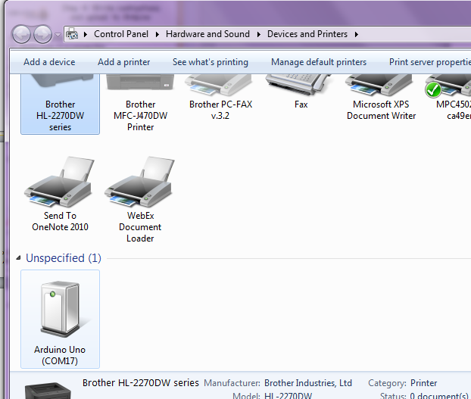
Make sure Windows detects Arduino correctly
Click on Windows logo at bottom left corner of the screen
Click on “Devices and Printers”
Arduino Uno should be listed there.
Note the port. Example COM17 in this image.

Slide 24

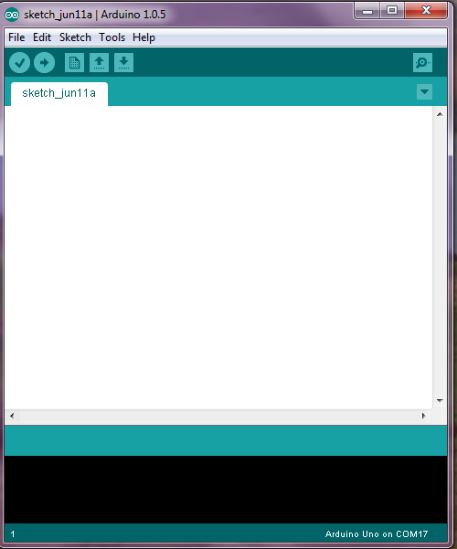
Open Arduino IDE
Click on the Arduino icon on your desktop
A window like this should open up
Arduino

Slide 25
What is integrated development environment or IDE?
This is the place where you write instructions for the Arduino
It checks the instructions can be understood by Arduino
Passes the “Sketch” to Arduino (“Upload”)
Allows us to chat with Arduino if needed.

Slide 26
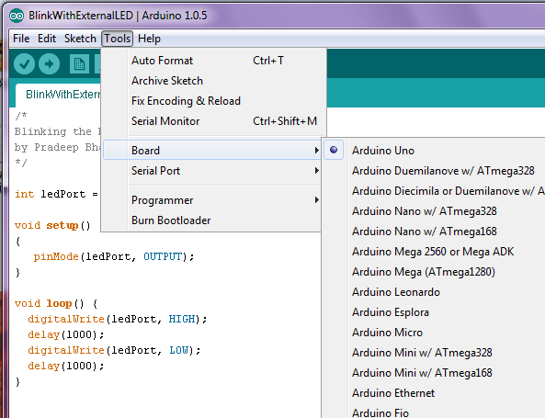
Select Board “Arduino Uno”

Slide 27
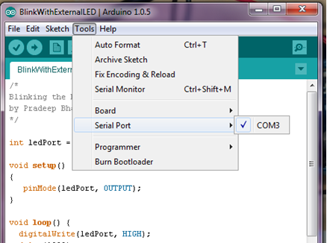
Select the Communication Port the computer uses to send the instructions to Arduino and talking to it.
Port you had noted earlier should be visible here.
Select it

Slide 28
Write the instructions (also called “Sketch”)
Click on menu option “File” in the Arduino IDE
Select “Sketchbook”. Select “Smart_light”.
The instructions similar to those in the next three slides will show up in the window
I have pre-written them to save time. In real life you will have to write them.
The programming language used is similar to C++.

Slide 29
Sketch Part 1
/*
Automatic light
Arduino is connected to a light sensor and a LED.
Arduino switches the LED on when it becomes somewhat dark.
It switches the LED off when it is bright.
by Pradeep Bhatter
*/
/* Use pin 9 to signal the LED */
const int LED_PIN = 9 ;
/* Use pin 0 for reading the level of brightness from the light sensor */
const int LIGHT_SENSOR_PIN = 0 ;
/* time the controller should wait before resensing - 1000 millisecond or 1 second */
const int INTERVAL = 1000 ;
/* Box to store the value read from brightness sensor */
int sensedValue ;
Notes:
Setup – called one time
INPUT or OUTPUT
Loop – continuously repeated
HIGH – 5V
LOW – 0V
Why do we use ledPort?
Why do we use Camel Case?

Slide 30
Sketch Part 2
void setup() {
/* My Dear Arduino, */
/* Use pin 9 for telling the LED to glow or not */
pinMode(LED_PIN, OUTPUT);
/* Use pin 0 to read the level of brightness from the light sensor */
pinMode(LIGHT_SENSOR_PIN, INPUT);
/* If connected to computer, set the speed to talk to it at 9600 bits/second */
Serial.begin(9600) ;
/* Tell the computer you are ready to roll */
Serial.println("Ready to roll ....");
delay (100);
}

Slide 31
Sketch Part 3
void loop() {
/* My Dear Arduino,
Keep doing what I telling you here ….
*/
/* Read the strength of the signal on pin connected to light sensor */
sensedValue = analogRead(LIGHT_SENSOR_PIN) ;
/* Read the pin light sensor is connected to.
If the value read is less than 400, set LED pin to 1. It will make the LED glow.
Otherwise, set the LED pin to 0. It will make the LED turn off.
*/
if (sensedValue < 400)
digitalWrite(LED_PIN, HIGH) ;
else
digitalWrite(LED_PIN, LOW) ;
/* Tell the computer, the value you read from light sensor */
Serial.print("Sensor Value = ");
Serial.println(sensedValue);
/* Wait and then go again ... */
delay (INTERVAL);
}

Slide 32
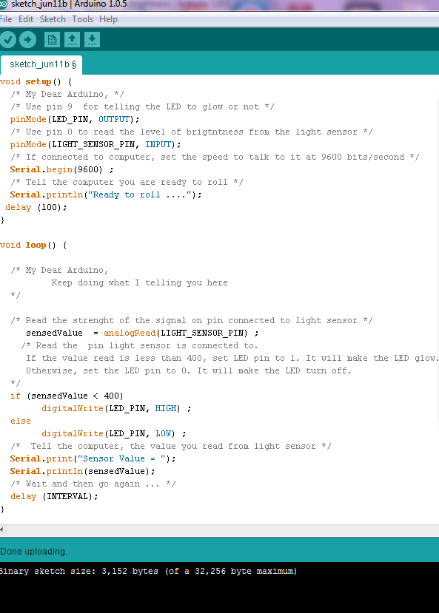
Upload the sketch to Arduino
Click on Upload to send the instructions from the computer to Arduino
Verify instructions were
Uploaded!!
And there were no errors
........

Slide 33
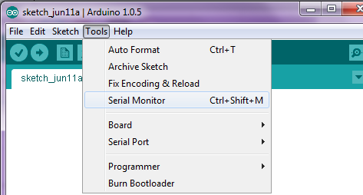
Open a chat window with the Arduino
Click on “Serial Monitor” in “Tools” menu.

Slide 34
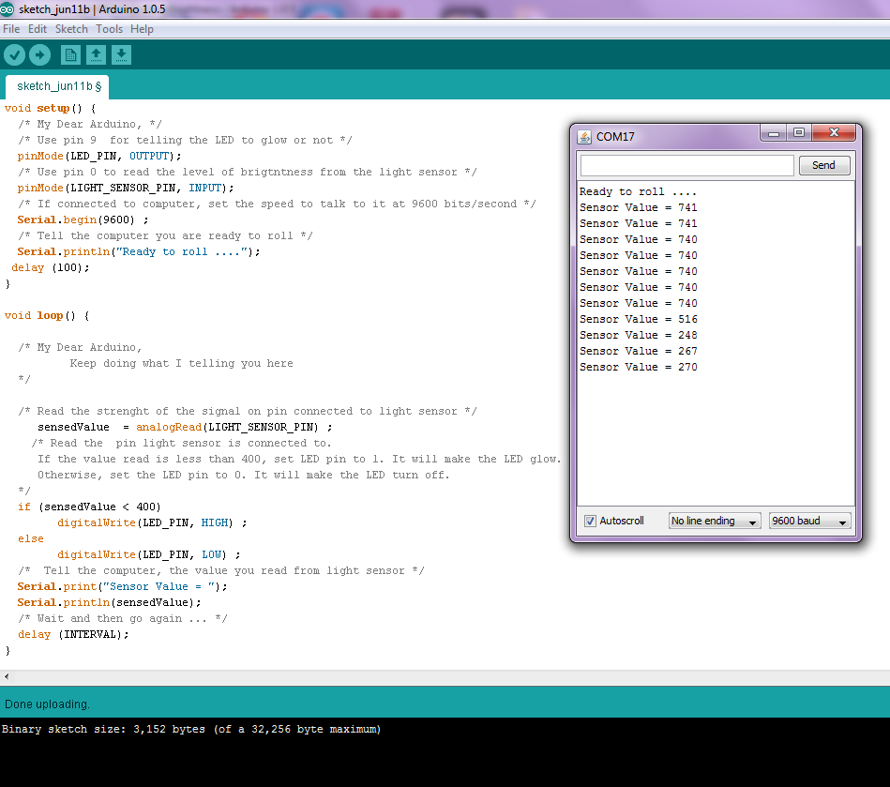

Slide 35
Show time!
Does chat window show the message from Arduino “Ready to roll …”
Does the chat window show the sensor value?
Go cover the sensor with your hand. Does the value change as you increase/decrease the light falling on the sensor? (if not, something is wrong. Call for help!)
Does it fall below 400 when you cover the light sensor? (if not, you may have to change and upload again.)
If the value falls below 400, does the LED glow?
Notes:
+ 1:25
Activity #2 Explain code – 10 minutes

Slide 36
Did it work?

Slide 37
Time for Arduino to take a break
Switch off the battery by sliding the switch to off
Disconnect the battery from Arduino
Remove all components from the bread board and pack them back neatly into the box.

Slide 38
Let us meet the new components ….

Slide 39
I am Light Dependent Resistor ….
You can call me LDR
When there is light, my resistance is low
More current flows thru me
When it is dark my resistance is high
Less current flows thru me

Slide 40
Software (or Sketch)

Slide 41
Sketch Part 1
/*
Automatic light
Arduino is connected to a light sensor and a LED.
Arduino switches the LED on when it becomes somewhat dark.
It switches the LED off when it is bright.
by Pradeep Bhatter
*/
/* Use pin 9 to signal the LED */
const int LED_PIN = 9 ;
/* Use pin 0 for reading the level of brightness from the light sensor */
const int LIGHT_SENSOR_PIN = 0 ;
/* time the controller should wait before resensing - 1000 millisecond or 1 second */
const int INTERVAL = 1000 ;
/* Box to store the value read from brightness sensor */
int sensedValue ;
Notes:
Setup – called one time
INPUT or OUTPUT
Loop – continuously repeated
HIGH – 5V
LOW – 0V
Why do we use ledPort?
Why do we use Camel Case?

Slide 42
Sketch Part 2
void setup() {
/* My Dear Arduino, */
/* Use pin 9 for telling the LED to glow or not */
pinMode(LED_PIN, OUTPUT);
/* Use pin 0 to read the level of brightness from the light sensor */
pinMode(LIGHT_SENSOR_PIN, INPUT);
/* If connected to computer, set the speed to talk to it at 9600 bits/second */
Serial.begin(9600) ;
/* Tell the computer you are ready to roll */
Serial.println("Ready to roll ....");
delay (100);
}

Slide 43
Sketch Part 3
void loop() {
/* My Dear Arduino,
Keep doing what I telling you here ….
*/
/* Read the strength of the signal on pin connected to light sensor */
sensedValue = analogRead(LIGHT_SENSOR_PIN) ;
/* Read the pin light sensor is connected to.
If the value read is less than 400, set LED pin to 1. It will make the LED glow.
Otherwise, set the LED pin to 0. It will make the LED turn off.
*/
if (sensedValue < 400)
digitalWrite(LED_PIN, HIGH) ;
else
digitalWrite(LED_PIN, LOW) ;
/* Tell the computer, the value you read from light sensor */
Serial.print("Sensor Value = ");
Serial.println(sensedValue);
/* Wait and then go again ... */
delay (INTERVAL);
}

Slide 44
Circuit Diagram
270 Ω
9 5V
A0
Arduino
W
10K Ω
GND
Notes:
+ 1:35 minutes

Slide 45
How does it work?
100 Ω
Bright
Lot’s of light !
2K Ω
9 5V
A0
Arduino
W
10K Ω
GND
LDR offers resistance of about 2500 ohms
Voltage across 10 Kilo Ω Resistor is about 4 volts
Current flowing 0.4 milli Amps
Arduino senses a value of about 800
on the Analog input port A0
Notes:
Show the sketch

Slide 46
How does it work?
100 Ω
Dark . No light!
500K Ω
9 5V
A0
Arduino
W
10K Ω
GND
LDR offers resistance of about 500,000 ohms
Voltage across 10,000 ohm resistor drops to about 0.01 volts
Current flowing drops to about 0.001 milli Amps
Arduino senses a value of about 2
on the Analog input port A0

Slide 47
Demo (if time permits) Remote controlled light
Uses the light sensor and LED circuit we built earlier
Instead of Arduino automatically switching on or off the LED, this time we will control it over the network.
Turn On or Turn Off the LED by sending command from another computer.

Slide 48
Connect to wireless network “devoxx4kids”

Slide 49
Use browser on your computer to send these commands …
http://192.168.0.126:42001/vars-update=Command=On
http://192.168.0.126:42001/vars-update=Command=Off
http://192.168.0.126:42001/vars-update=Command=On=Name=Pradeep
http://192.168.0.126:42001/?send_vars

Slide 50
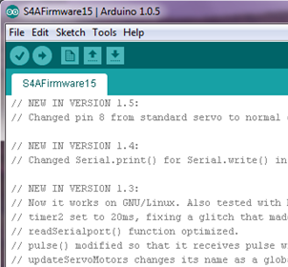

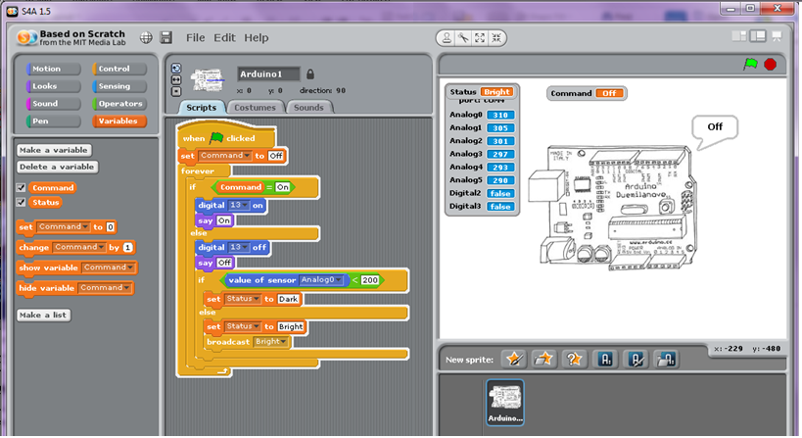
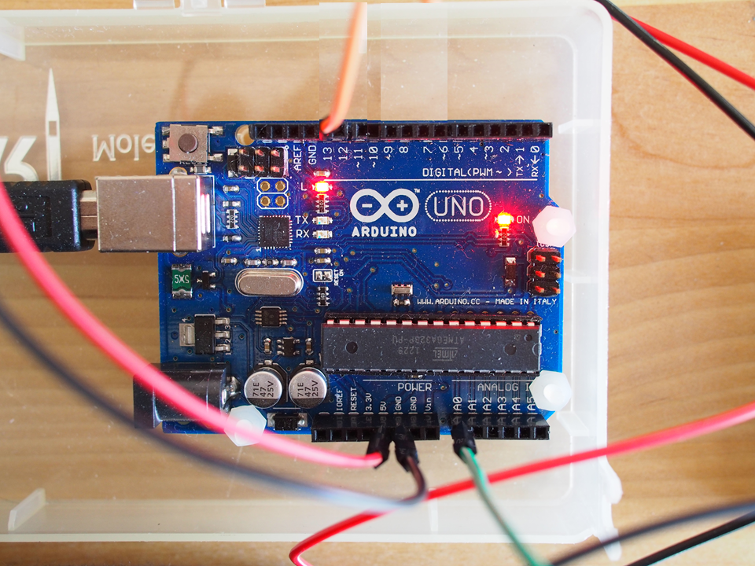

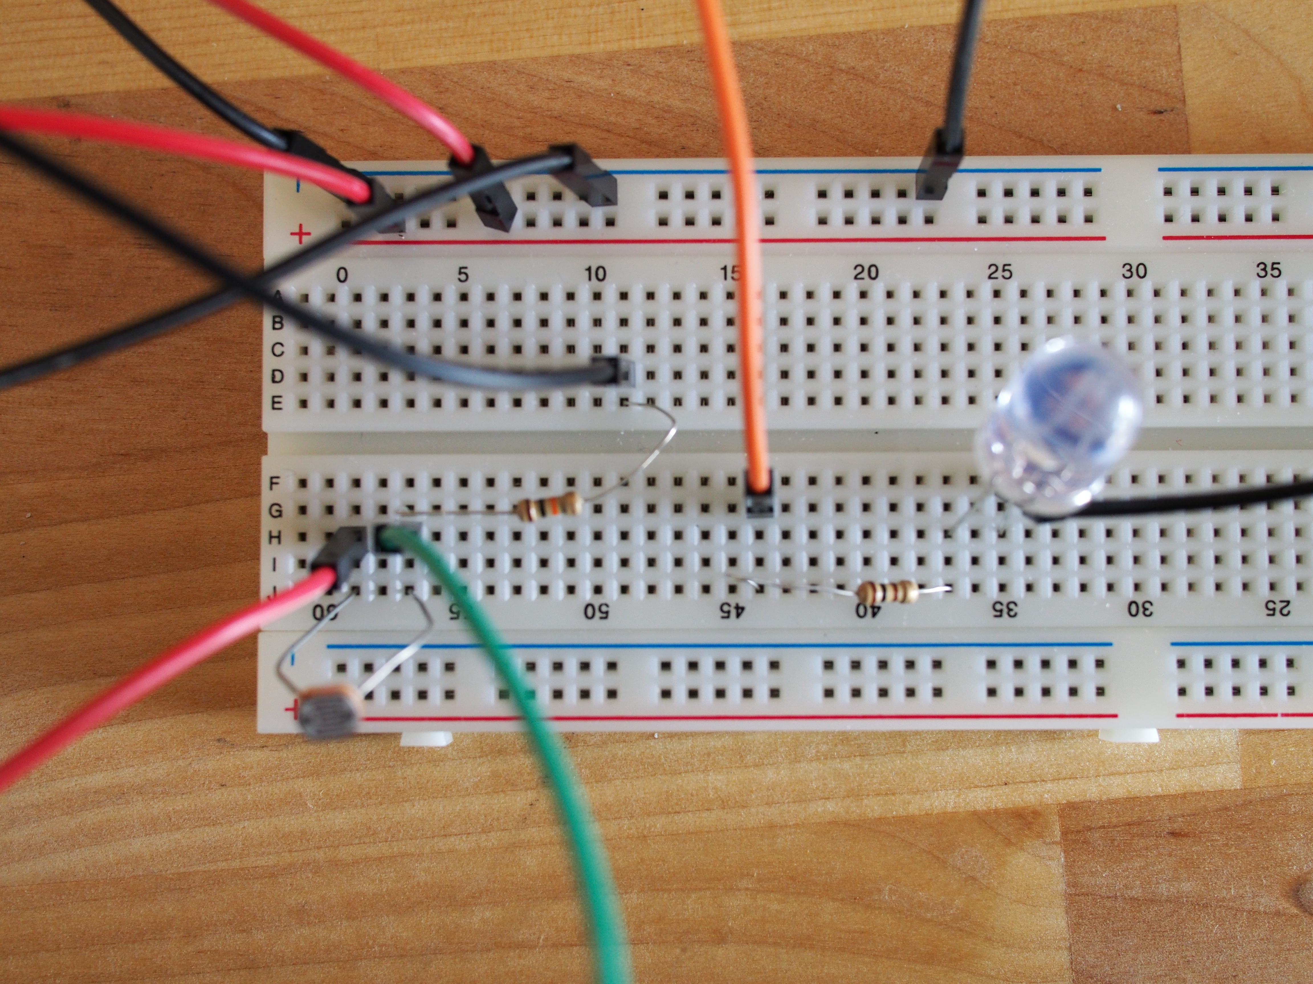
How does it work?
Scratch Program
Network

Slide 51
Let’s meet the Arduino again ….
I/O pins
Reset pin
USB
Port
LEDs
ATMega328 MC
7-12V
DC input
Power pins
Analog input pins

Slide 52

Joining hands …
Internet of Things
Sensors
Controllers
Wireless &
Network
Apps
Mobile devices
Cloud

Slide 53
Books
Exploring Arduino by Jeremy Blum
Programming Arduino Getting Started with Sketches by Simon Monk
Programming Arduino Next Steps by Simon Monk
Arduino Cookbook by Michael Margolis
The Art of Tinkering by Karen Wilkinson and Mike Petrich
Getting Started with Arduino by Massimo Banzi
The Design of Everyday Things by Donald A. Norman

Slide 54
Useful websites
Arduino
Comic http://playground.arduino.cc/Main/ArduinoComic
http://arduino-info.wikispaces.com/
Reference www.arduino.cc/en/Reference/HomePage
Forum www.arduino.cc/forum
Ideas for projects
http://www.instructables.com/
http://makezine.com/
Excellent tutorial on Electricity, Circuits
http://www.allaboutcircuits.com/
http://www.wikipedia.org/
https://learn.sparkfun.com/tutorials/what-is-electricity

Slide 55
Thank you
O'Reilly Media
Allison Gillespie - O'Reilly Media
Andrew King & team
O’Reilly OSCON Team
Welden, Robert and other parents
I am Arduino!
나는 아두 이노입니다
मैं अरदुनओ हूँ
我的Arduino!
Ik ben Arduino!
Sono Arduino!
Je suis Arduino

